Slide 1
Investigation on Monte Carlo Method
Haocheng An
11/30/2017

Slide 3



Gauss Seidel
Monte Carlo Estimating Pi
Monte Carlo Solve Laplace
Solve SDE

Slide 4
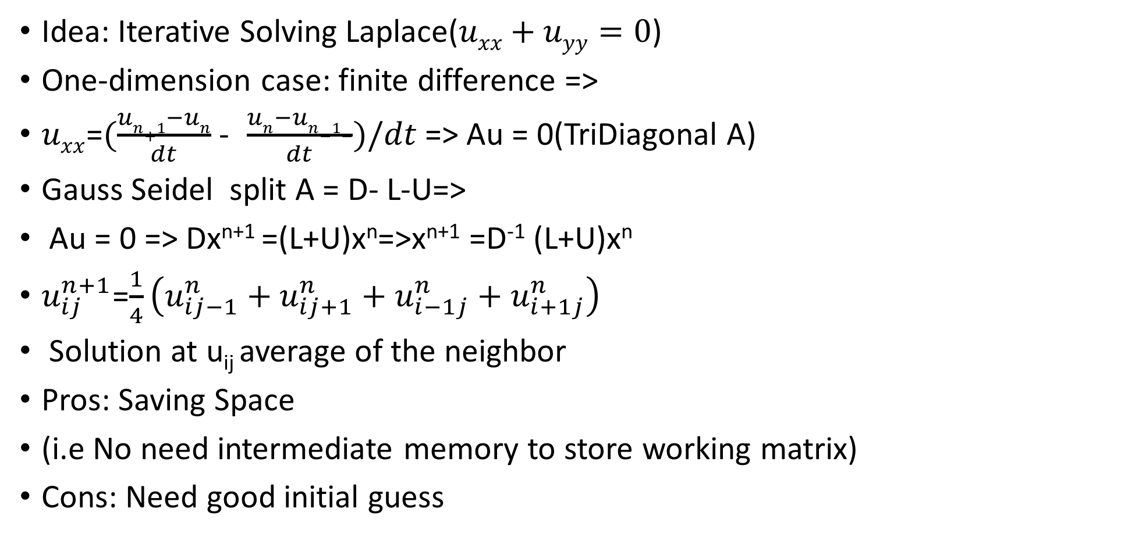
Gauss Seidel
Idea: Iterative Solving Laplace($uxx+uyy=0$)
One-dimension case: finite difference =>
$uxx$=$(\frac{un+1−un}{dt}$ - $\frac{un−un−1−}{dt})/dt$ => Au = 0(TriDiagonal A)
Gauss Seidel split A = D- L-U=>
Au = 0 => Dx^{n+1} =(L+U)x^{n}=>x^{n+1} =D⁻¹ (L+U)x^{n}
$u_{ij}^{n+1}$=$\frac{1}{4}\left(u_{ij−1}^{n}+u_{ij+1}^{n}+u_{i−1j}^{n}+u_{i+1j}^{n}\right)$
Solution at u_{ij} average of the neighbor
Pros: Saving Space
(i.e No need intermediate memory to store working matrix)
Cons: Need good initial guess

Slide 5
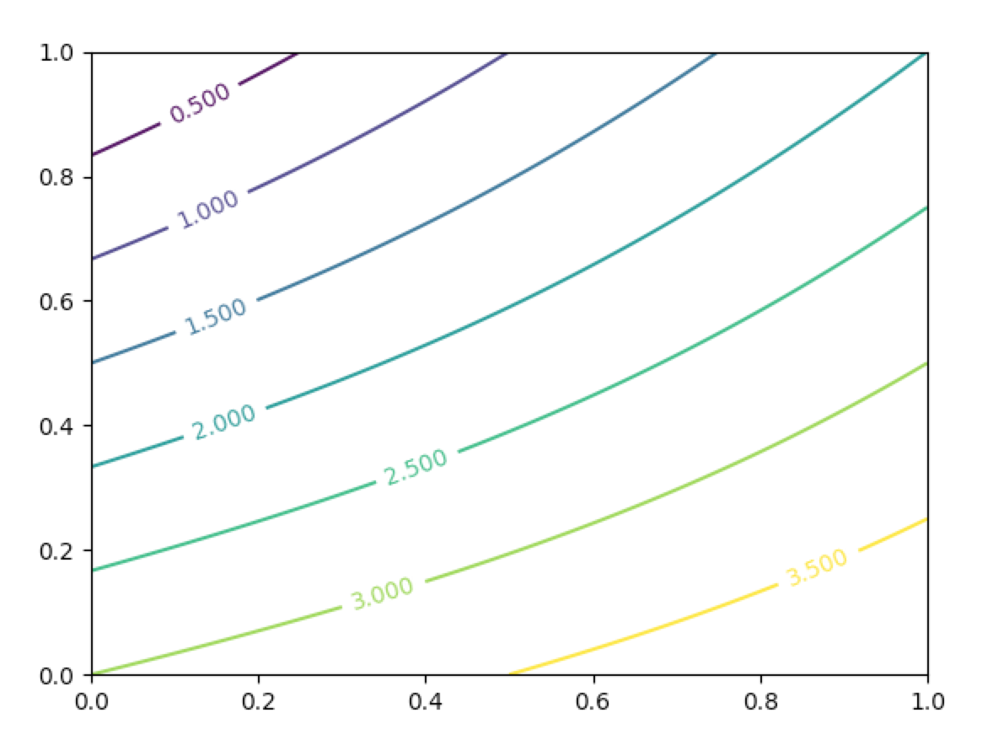

Example
u(x,0) = 2*x
u(x,1) = 3+x
u(0,y) = 3+y
u(1,y) =2*y
Error term
$\sum_{i=0}^{n}{\sum_{j=0}^{n}{||aij{−a}^{′}ij ||2}}$
0.000679298300794

Slide 6
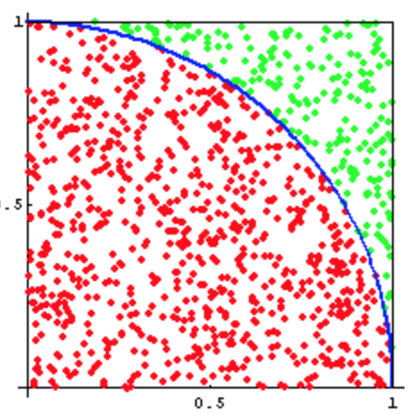
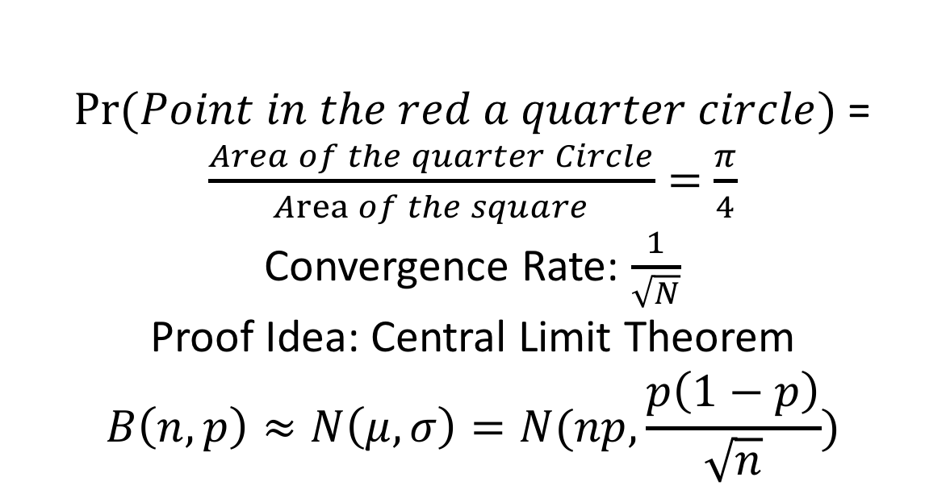
Monte Carlo Estimating Pi
$Pr⁡(Point in the red a quarter circle)$=$\frac{Area of the quarter Circle}{Area of the square}=$ $\frac{π}{4}$
Convergence Rate: $\frac{1}{\sqrt{N}}$
Proof Idea: Central Limit Theorem
$$B\left(n,p\right)≈N\left(μ,σ\right)=N(np,\frac{p\left(1−p\right)}{\sqrt{n}})$$

Slide 7
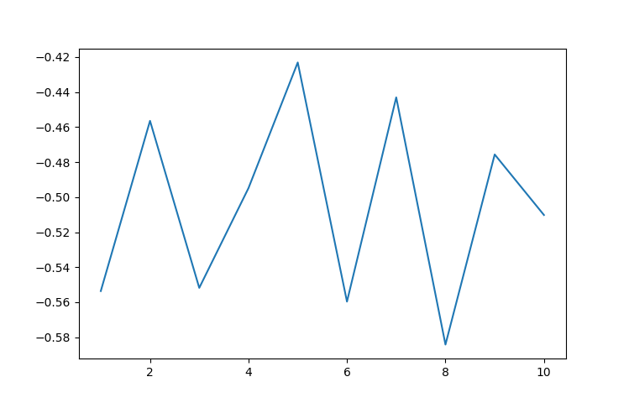

Convergence Rate = Ratio Error:
$log2$ [ error(2N)/ error(N)]

Slide 8
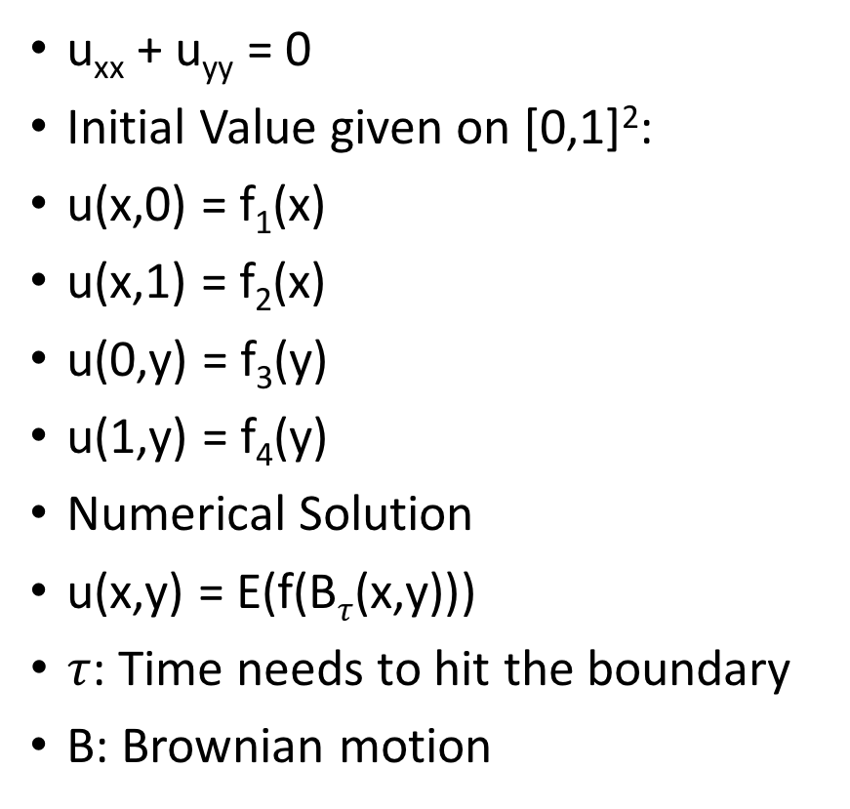
Monte Carlo Solve Laplace
u_{xx} + u_{yy} = 0
Initial Value given on [0,1]²:
u(x,0) = f₁(x)
u(x,1) = f₂(x)
u(0,y) = f₃(y)
u(1,y) = f₄(y)
Numerical Solution
u(x,y) = E(f(B$τ$(x,y)))
$τ$: Time needs to hit the boundary
B: Brownian motion
Rough Idea on Proof
1d:
U_{xx} = 0 u(0) = a, u(1) = b
Deterministic Solution
→ u(x) = (b-a)x + a
Probabilistic on given point x:
Each Step: Left Right
Probability 0.5 0.5
Touch boarder: Left Right
Probability 1-x x
u(x) = x*b + (1-x)*a =(b-a)*x + a

Slide 9
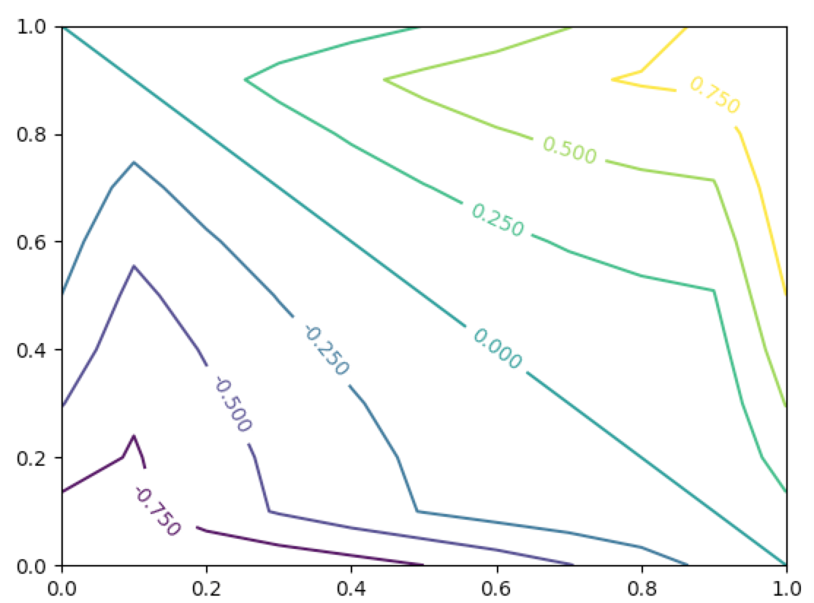
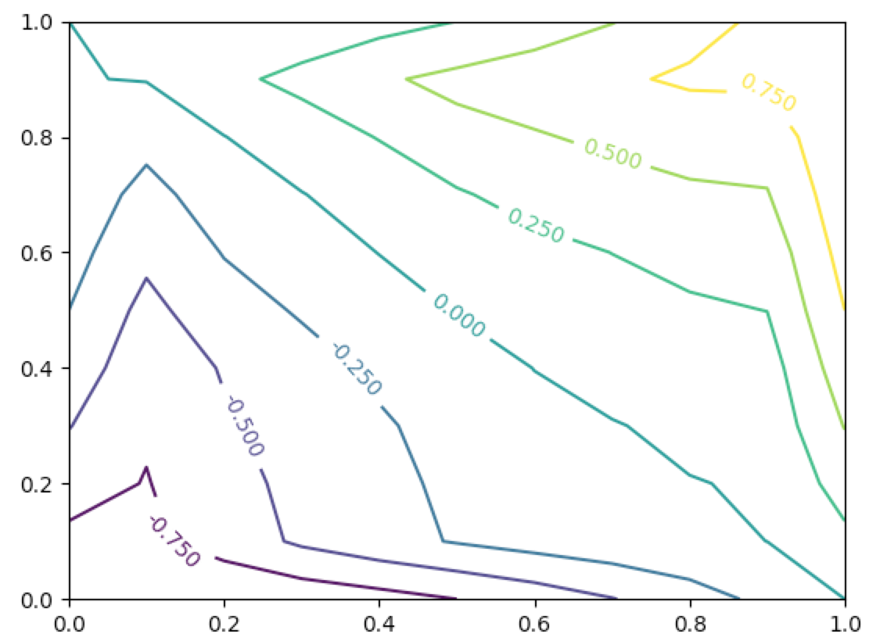
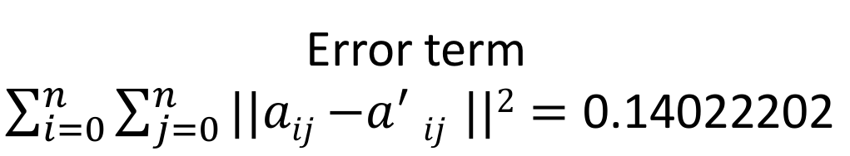
Example:
Analytical Solution: u(x, y) = x²-y²
u(x,0) = x²
u(x,1) = x²-1
u(0,y) = -y²
u(1,y) = 1- y²
Error term $\sum_{i=0}^{n}{\sum_{j=0}^{n}{||aij{−a}^{′}ij ||2}=\text{0.14022202 }}$

Slide 10
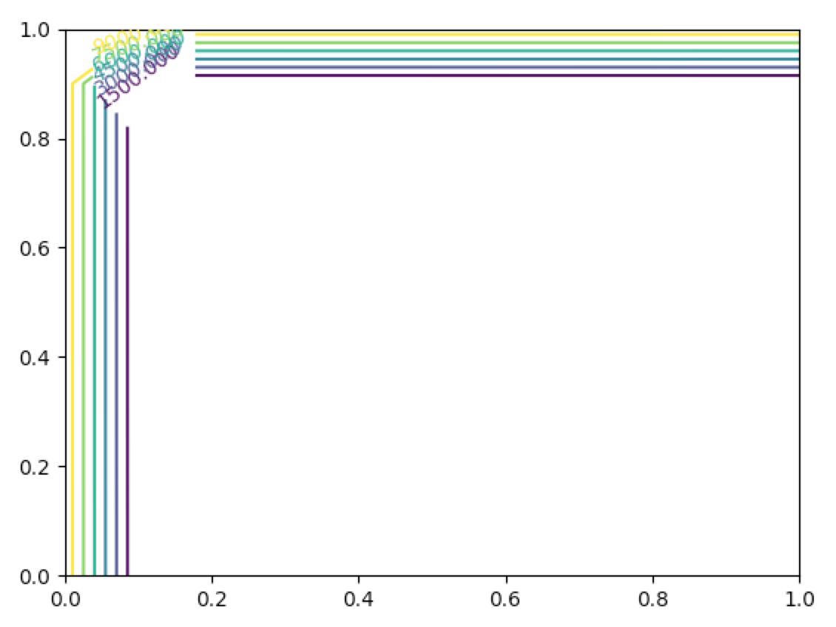
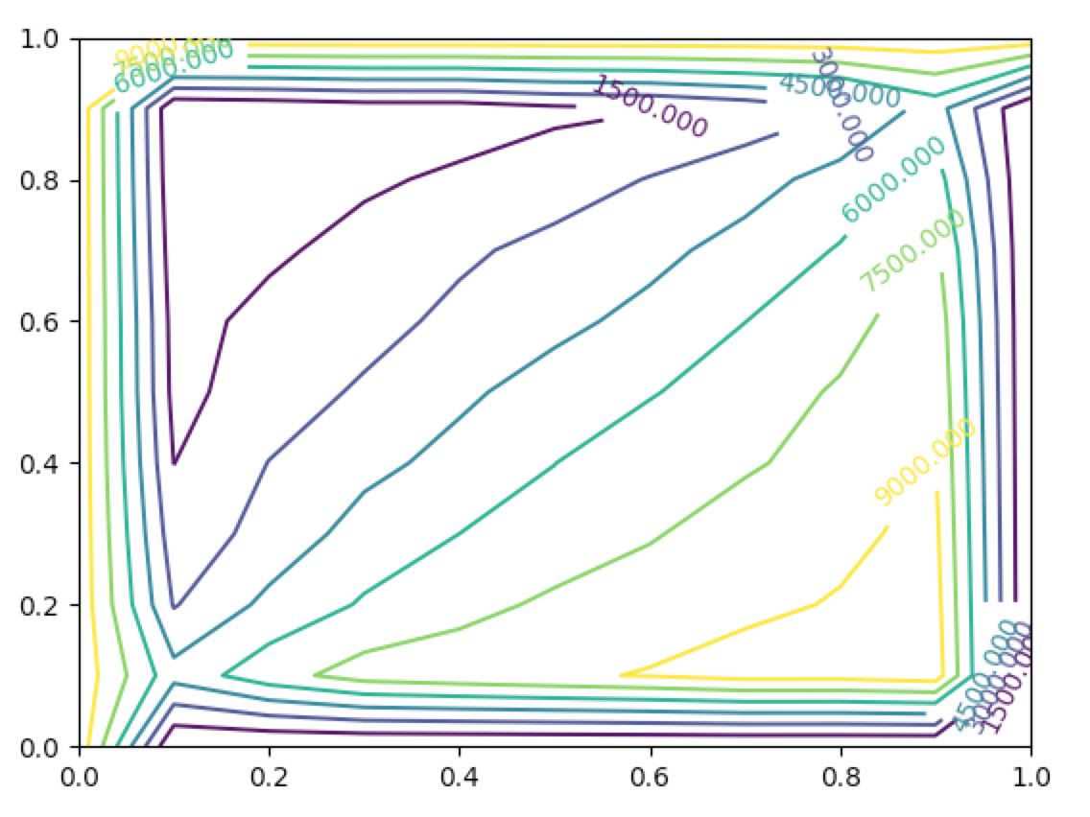
Importance of 0 = u_{xx} + u_{yy}
Actual Solution: $u\left(x, y\right)=\frac{1}{xy}$
Error term:51898.4903672

Slide 11
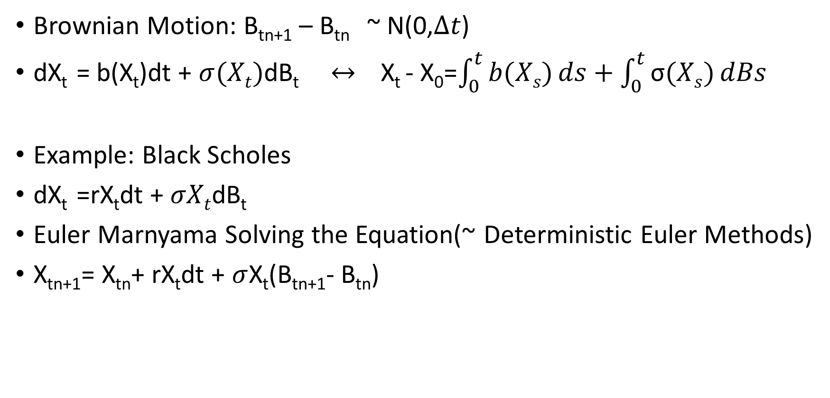
Solve Stochastic Differential Equations
Brownian Motion: B_{tn+1} – B_{tn} ~ N(0,$∆t$)
dX_{t} = b(X_{t})dt + $σ(Xt)$dB_{t} $↔$ X_{t} - X₀=$\int_{0}^{t}{b(Xs)}ds+\int_{0}^{t}{\text{σ}(Xs)}dBs$
Example: Black Scholes
dX_{t} =rX_{t}dt + $σXt$dB_{t}
Euler Marnyama Solving the Equation(~ Deterministic Euler Methods)
X_{tn+1}= X_{tn}+ rX_{t}dt + $σ$X_{t}(B_{tn+1}- B_{tn})

Slide 12
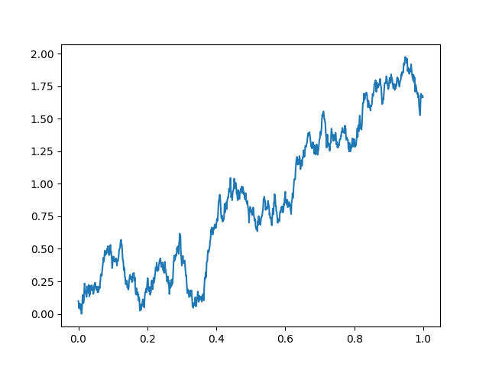

Take r = $\text{σ}$ = 1

